Slide 1
G191: Sportsbook HP Footer
First Version – Desktop Only
16th November

Slide 2
Sportsbook HP Footer
Insight:
The business would like to increase the exposure of sportsbook at times relevant to key football matches to increase the volume of targeted traffic generating betting slips – hopefully increasing the probability of bets being placed.
Hypothesis:
By showing live odds from the kambi widget, just before premiership matches, on the home page we expect visits to sportsbook to change
Include URLs: www.grosvenorcasinos.com (home page only)
Audience / Segments: Include All visitors between times and dates 1 hour before matches until the end of the match (Saturday& Sunday 11:00 to 1800) Desktop Only | Exclude Master Control
Exclude URLs: by definition anything that isn’t the homepage
Device: Desktop
Created By: | Ben Thomas
Approved By: | Kerry Dawes
Developer: | Stefano Lissia
Tested By: | Heena Kothari
Stakeholder: | Anthony Conroy
KPIs: Primary: Visits to sportsbook Secondary: Deposit Value, Deposit Count

Slide 3
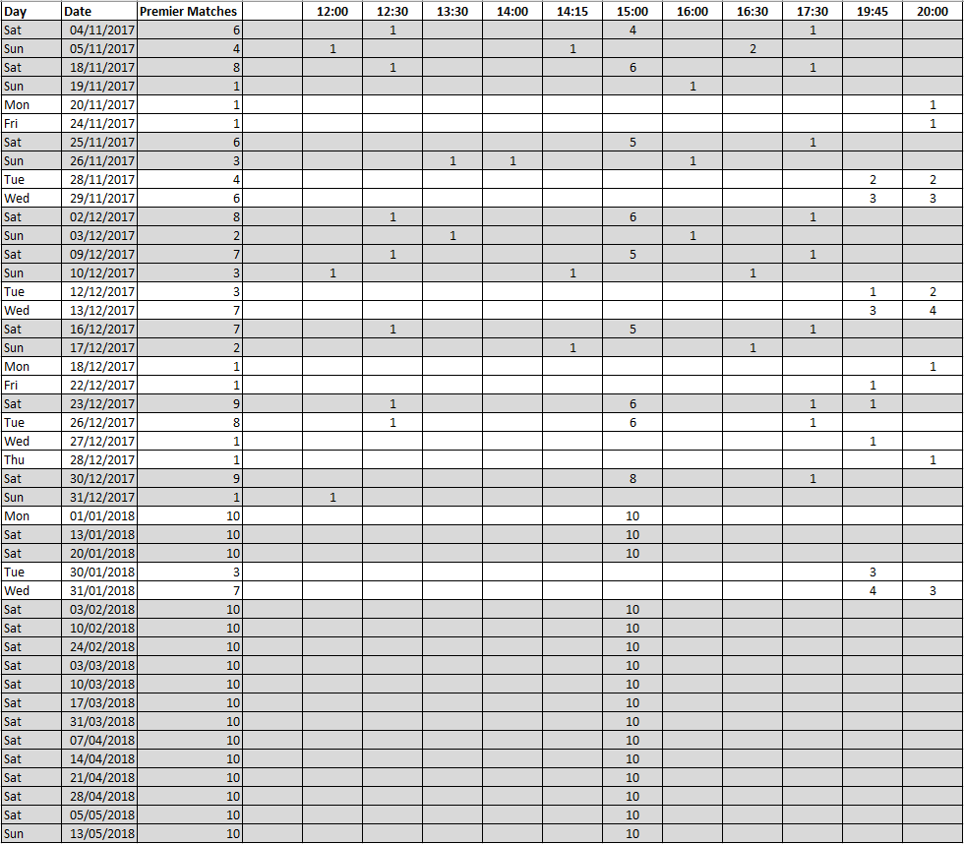
Insights
For premiership matches
Weekday (typically Tue/Wed) matches start at 19:45 or 20:00
Weekend matches generally start at 15:00 with
1 lunchtime match at 12:30, and
1 dinner time match around 17:30
N.B. These times are subject to change nearer the match day

Slide 4
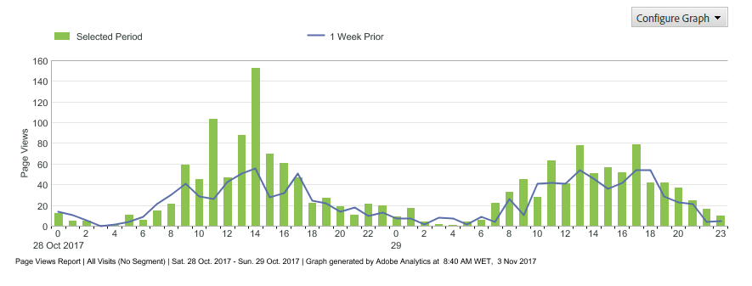
Weekend Traffic to Football Page
Traffic peaks an hour before the match ( )

Slide 5
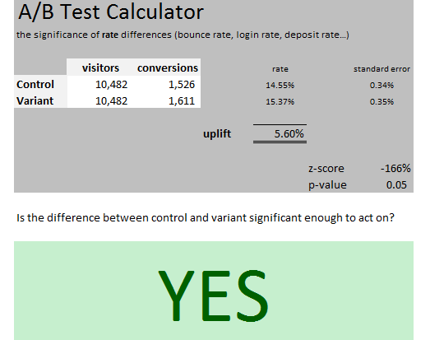
Minimum Uplift for Sportsbook Visits to be Significant
Traffic volumes from 4-5 November 17
Home page to Sportsbook visits need to increase by 5.6% to be significant.
This uplift will be smaller as traffic builds across multiple weekends.

Slide 6
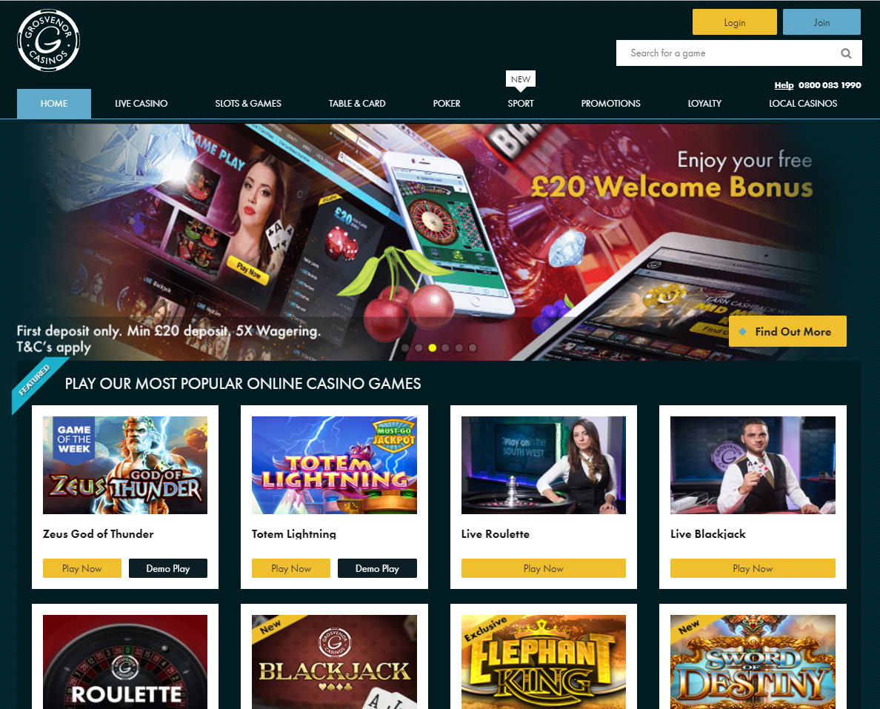
Control - Desktop
Location and Variant
Home page
Audience/ Segment
50% of all traffic during specified dates and times
Desktop Traffic

Slide 7
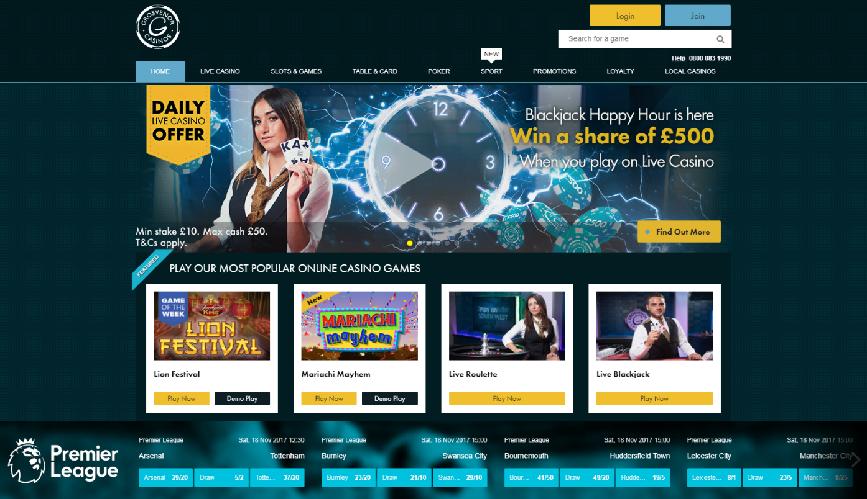
Desktop Variant (Full Width)
Location and Variant
Home page
Sticky footer with kambi widget showing imminent football matches
Clicking the kambi widget takes the customer through to the sports page
We will need to measure traffic coming through navigation or banner to determine how we’re impacting the traffic flow
Audience/ Segment
50% of traffic during specified dates and times
Desktop traffic

Slide 8
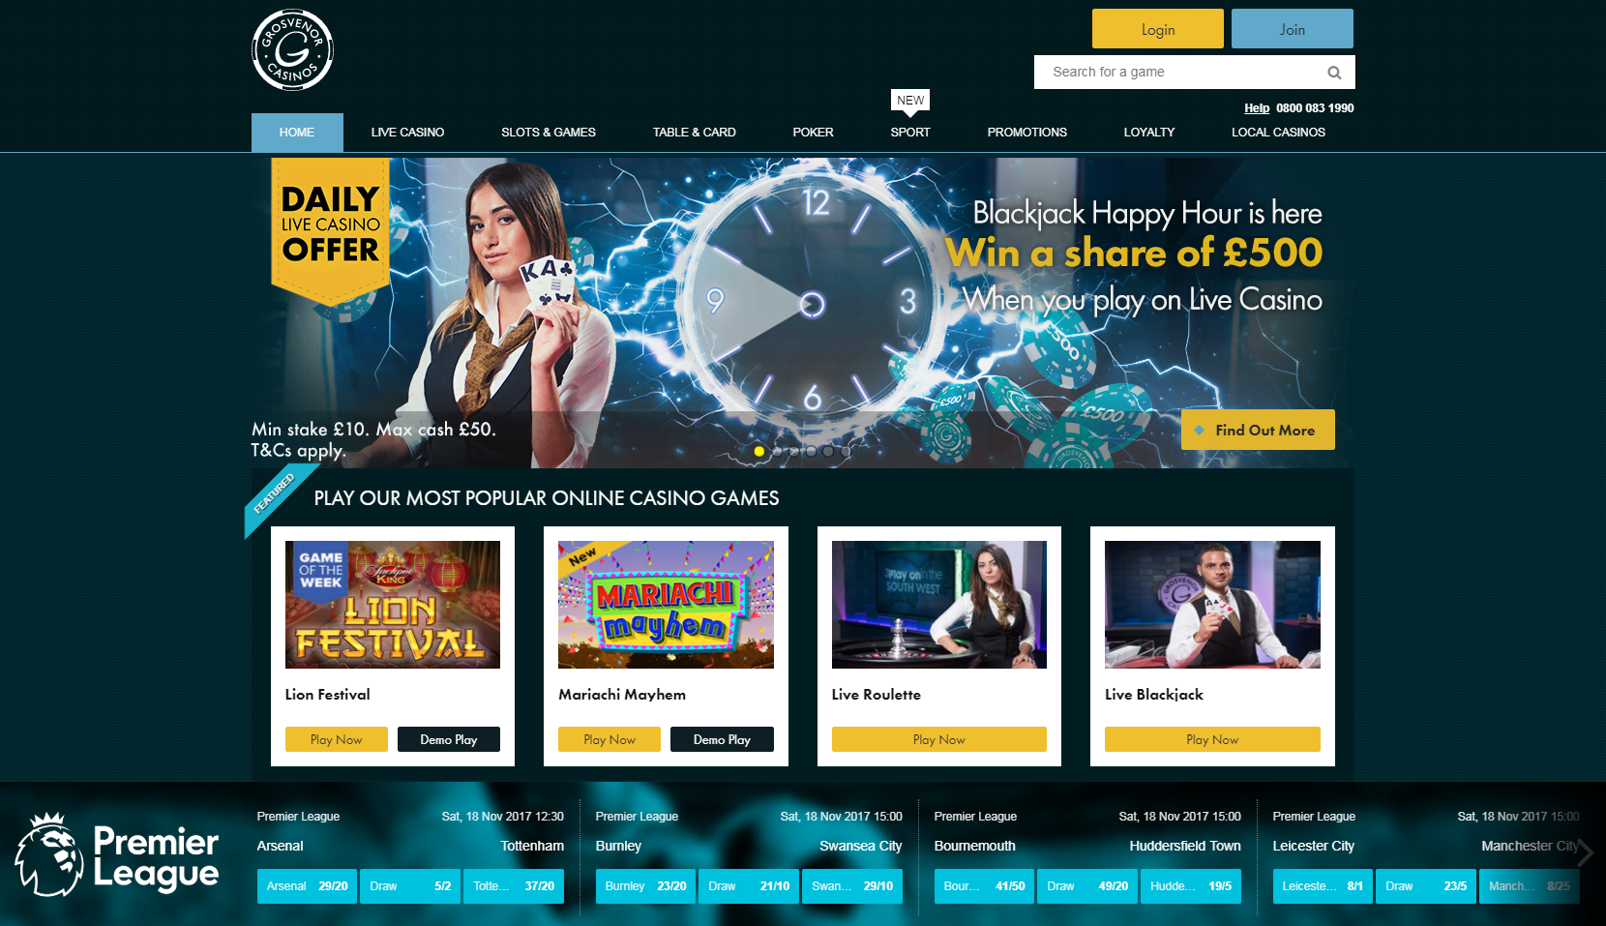
Footer Details
100% width footer resizes with window width
Premiership games listed as per grosvenorcasino.com/sport
Footer is sticky and shows at the bottom of the home page only
White keyline separating from rest of page
Buttons take the visitor through to the game page
Close button hides the banner
Footer ‘scrolls’ up gradually to full height on loading the page
X

Slide 9
Other considerations
Link to sportsbook will need to be tracked to differentiate it from the navigation.
Bet slips should not be triggered on the home page
The kambi widget carries with it page performance issues. This will have to be considered in the final implementation once the concept is approved.

Slide 10
END

